Slide 1
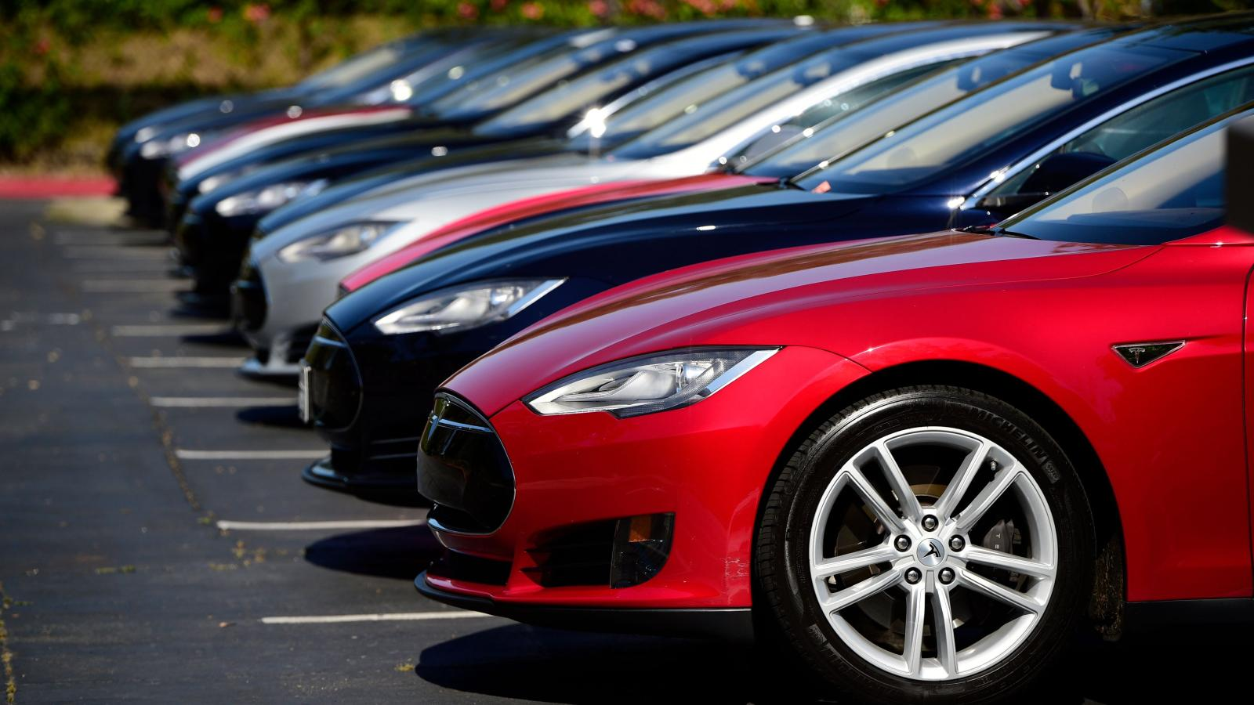
Car Price Prediction
Priyadarsi Das
priyadarsidas1@gmail.com

Slide 2
Scope of data science project
Data science tends to fall into three broad categories:
Investigating – aggregating and inspecting data to get basic insights on what is currently happening
Predicting – taking the data and using it to understand what will happen in the future
Optimizing – using the data to choose what the best choice of actions will be
Simple
Complex

Slide 3
Process
Questions
Data
Analysis
Modeling
Abort
Result
Productionize

Slide 4
About the project
Data Collection Phase
You have to scrape at least 5000 used cars data. You can scrape more data as well, it’s up to you. more the data better the model
In this section You need to scrape the data of used cars from websites (Olx, cardekho, Cars24 etc.) You need web scraping for this. You have to fetch data for different locations. The number of columns for data doesn’t have limit, it’s up to you and your creativity. Generally, these columns are Brand, model, variant, manufacturing year, driven kilometers, fuel, number of owners, location and at last target variable Price of the car. This data is to give you a hint about important variables in used car model. You can make changes to it, you can add or you can remove some columns, it completely depends on the website from which you are fetching the data.
Try to include all types of cars in your data for example- SUV, Sedans, Coupe, minivan, Hatchback.

Slide 5
About the project
Model Building Phase
After collecting the data, you need to build a machine learning model. Before model building do all data pre-processing steps. Try different models with different hyper parameters and select the best model.
Follow the complete life cycle of data science. Include all the steps like.
1. Data Cleaning
2. Exploratory Data Analysis
3. Data Pre-processing
4. Model Building
5. Model Evaluation
6. Selecting the best model

Slide 6
Business Goal
With the covid 19 impact in the market, we have seen lot of changes in the car market. Now some cars are in demand hence making them costly and some are not in demand hence cheaper. One of our clients works with small traders, who sell used cars. With the change in market due to covid 19 impact, our client is facing problems with their previous car price valuation machine learning models. So, they are looking for new machine learning models from new data. We have to make car price valuation model.

Slide 7
Outline
Web scrapping Data from olx.com
Perform Exploratory Data Analysis
Handle Null Values
Check for outliers
Check co-relation of variables
Check for skewness
Find best random state
Train Test Split
Model Building, Feature Selection, Feature Extraction
Hyper-parameter Tuning
Saving the model

Slide 8
Variable Properties
Make
Model
Year
Owner
Transmission
Fuel
Kms
Location
Price (Target Variable)

Slide 9
EDA
, is replaced from the columns
Rows having String values in integer columns are dropped
Object columns with integer values are converted to integer
Object columns with string values are label encoded
On removing outliers by z score method, 5% data loss is incurred, hence outliers are removed from the dataset
Skewness is checked with Power transformation. However, the base data has no skewness, hence transformer is not applied
The best random state is found to be 71. Same is used for train test split.
There are no null values in the dataset

Slide 10
EDA Observations
Most of the cars were bought in between 2000 – 2010
Most of the cars were used by 1 owner
Transmission has 2 categories: Automatic and Manual
Fuel has 5 categories
Variable linearly related to Price column: Year, Number of Owners, Kms used
Automatic vehicles are high priced
Petrol vehicles have highest price followed by LPG and then Electric
CNG & Hybrid vehicles are lowest priced vehicles

Slide 11
Model Building without Pipelines
0.916
Linear Regression
R2 Score: 0.40
It is seen that applying lasso does not improve the score
Catboost Regressor
R2 Score 0.52
Decision Tree Regressor
R2 Score: 0.48
----------------------------------------------------
Hyperparameter tuning on Catboost Regressor gives us
R2 Score: 0.77

Slide 12
Model Building with Pipelines
Standard Scaler + Different Models gives the following results:
('XGB', 0.8424667717647588),
('RandomForest', 0.7949179019446566),
('Bagging', 0.7762161601759182),
('GradientBoosting', 0.734116661368993),
('ExtraTree', 0.7233775207437104),
('DecisionTree', 0.5909982204250677),
('KNeighbors', 0.5089155317478375),
('AdaBoost', 0.38373907347431807),
('BayesianRidge', 0.3502038442424747),
('Ridge', 0.3501652582578137),
('Lasso', 0.350162802733961),
('LinearRegression', 0.3501626546848372),
('SGD', 0.34979365115350963),
('ElasticNet', 0.3222970175035715),
('Huber', 0.2647695899098993),
('RANSAC', 0.08260287556220287)

Slide 13
Applying Feature Selection
SelectKBest and f_regression is used to select 30 best parameters
('XGB', 0.849262991659535),
('RandomForest', 0.7997260800872877),
('Bagging', 0.7835757928149858),
('GradientBoosting', 0.7300818306326006),
('ExtraTree', 0.7185206656951154),
('DecisionTree', 0.6627224674221378),
('KNeighbors', 0.5456486678739007),
('BayesianRidge', 0.35023447737418684),
('Ridge', 0.35020159541006624),
('Lasso', 0.3501992085305186),
('LinearRegression', 0.350199069913208),
('SGD', 0.3497131339337049),
('ElasticNet', 0.3223121412271344),
('AdaBoost', 0.2872911020457127),
('Huber', 0.2648569717502475),
('RANSAC', 0.07812810827011604)

Slide 14
Applying Feature Extraction
Standard Scaler and PCA are used to perform Feature Extraction
('ExtraTree', 0.5879755665783052),
('RandomForest', 0.5552465764365048),
('XGB', 0.527519633941352),
('KNeighbors', 0.5016577937919695),
('Bagging', 0.49949617075948327),
('GradientBoosting', 0.48182888661437456),
('BayesianRidge', 0.35020043398830386),
('Ridge', 0.3501654713184062),
('Lasso', 0.35016272284814),
('LinearRegression', 0.3501626546848372),
('SGD', 0.34855478257073863),
('ElasticNet', 0.3139694795721067),
('Huber', 0.264555989435908),
('DecisionTree', 0.19767011293968223),
('AdaBoost', 0.19442699253775547),
('RANSAC', 0.08051001481974362)

Slide 15
Hyper parameter Tuning of Final Models
Models and R2 Score with GridSearchCV
'RandomForest', 0.77
'GradientBoosting', 0.83
‘Random Forest’ : 0.79
‘XGB’ : 0.85

Slide 16
Conclusion
Base models with pipelines will all features gives better results than applying Feature Selection & Feature Extraction.
XGB is selected as the final model at R2 Score of 85.87 with Hyper-parameter tuning.

